Slide 1
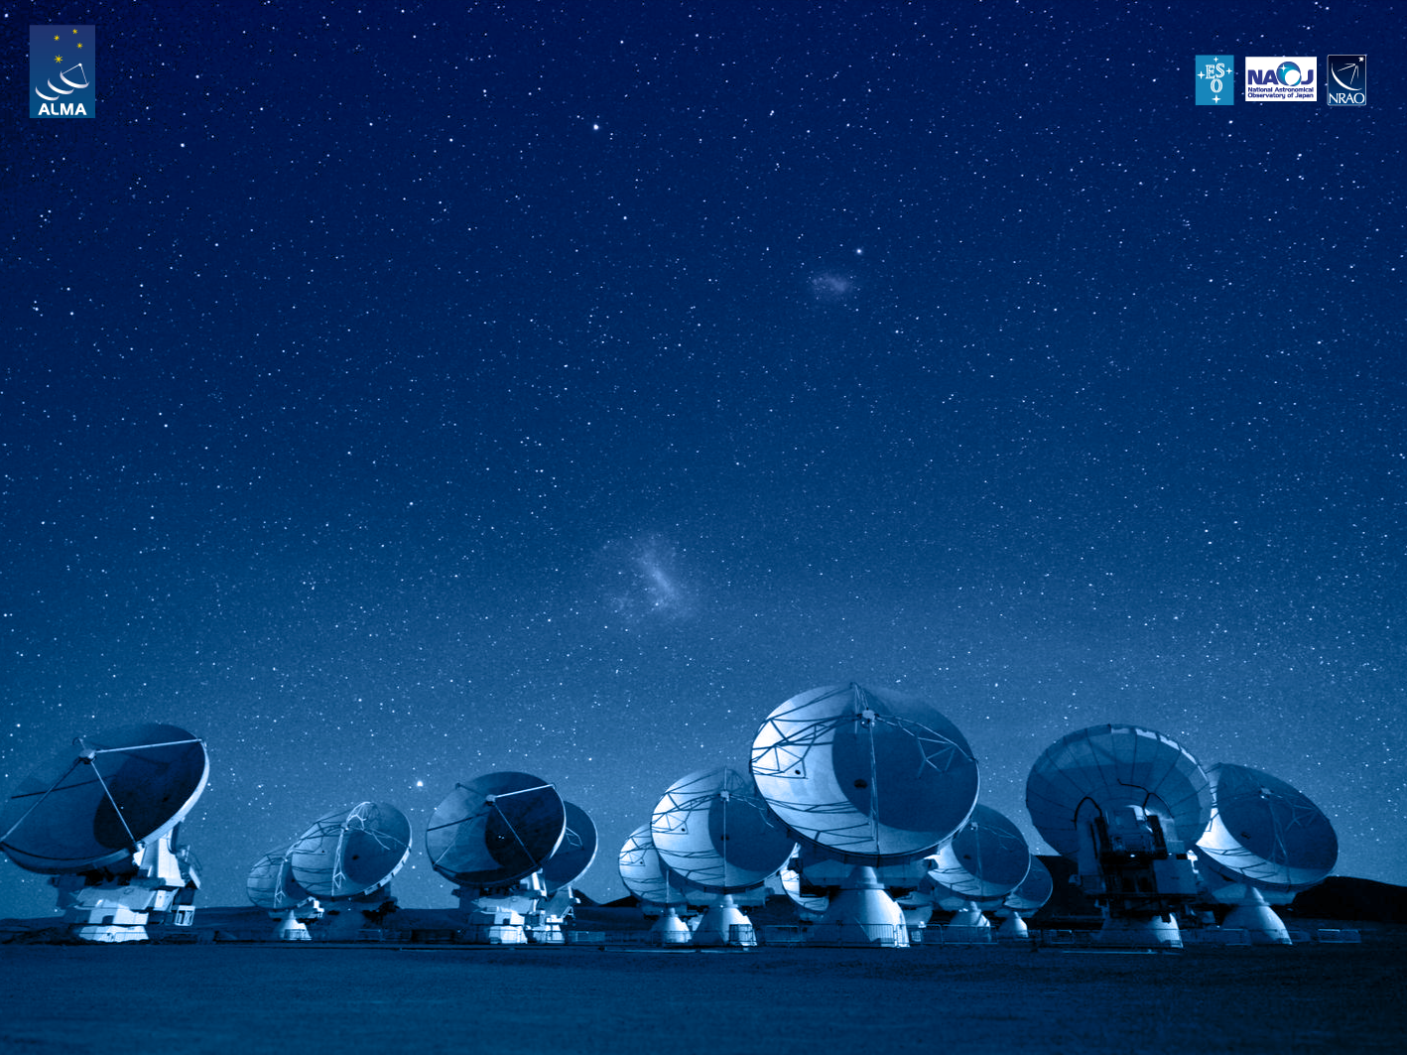
ALMA Common Software Basic Track
Configuration Database

Slide 2
Purpose
The ACS Configuration Database addresses the problems related to defining, accessing and maintaining the configuration of a system
For each Component on the system, there might be a set of static (or quasi-static) configuration parameters that have to be configured in a persistent store and read when the Component is started up or re-initialized
Basic components may or may nor have configuration information in the CDB
CharacteristicComponents, on the other hand, MUST have configuration information in the CDB

Slide 3
Configurable deployment
This includes the “structure” of the system, i.e. which statically deployed components are part of the system and their inter-relationships.
Just by looking at the CDB, you should be able to see how the components are distributed among the containers and on what hosts the containers are running
For Components connected to hardware, this would tell you as well what hardware you are using and where it is located
By changing the CDB you can move components around and distribute them in a different way in the system
Dynamic components can be partially deployed in the CDB – the missing info gets added at runtime.

Slide 4
Data organization
CDB (root)
MACI (system deployment data)
Managers
Containers
Components (just component deployment data)
Channels
alma (component specific data)
Two implementations available:
File-based as a directory structure within the file system (default)
Relational database using Oracle (ALMA specific)

Slide 5
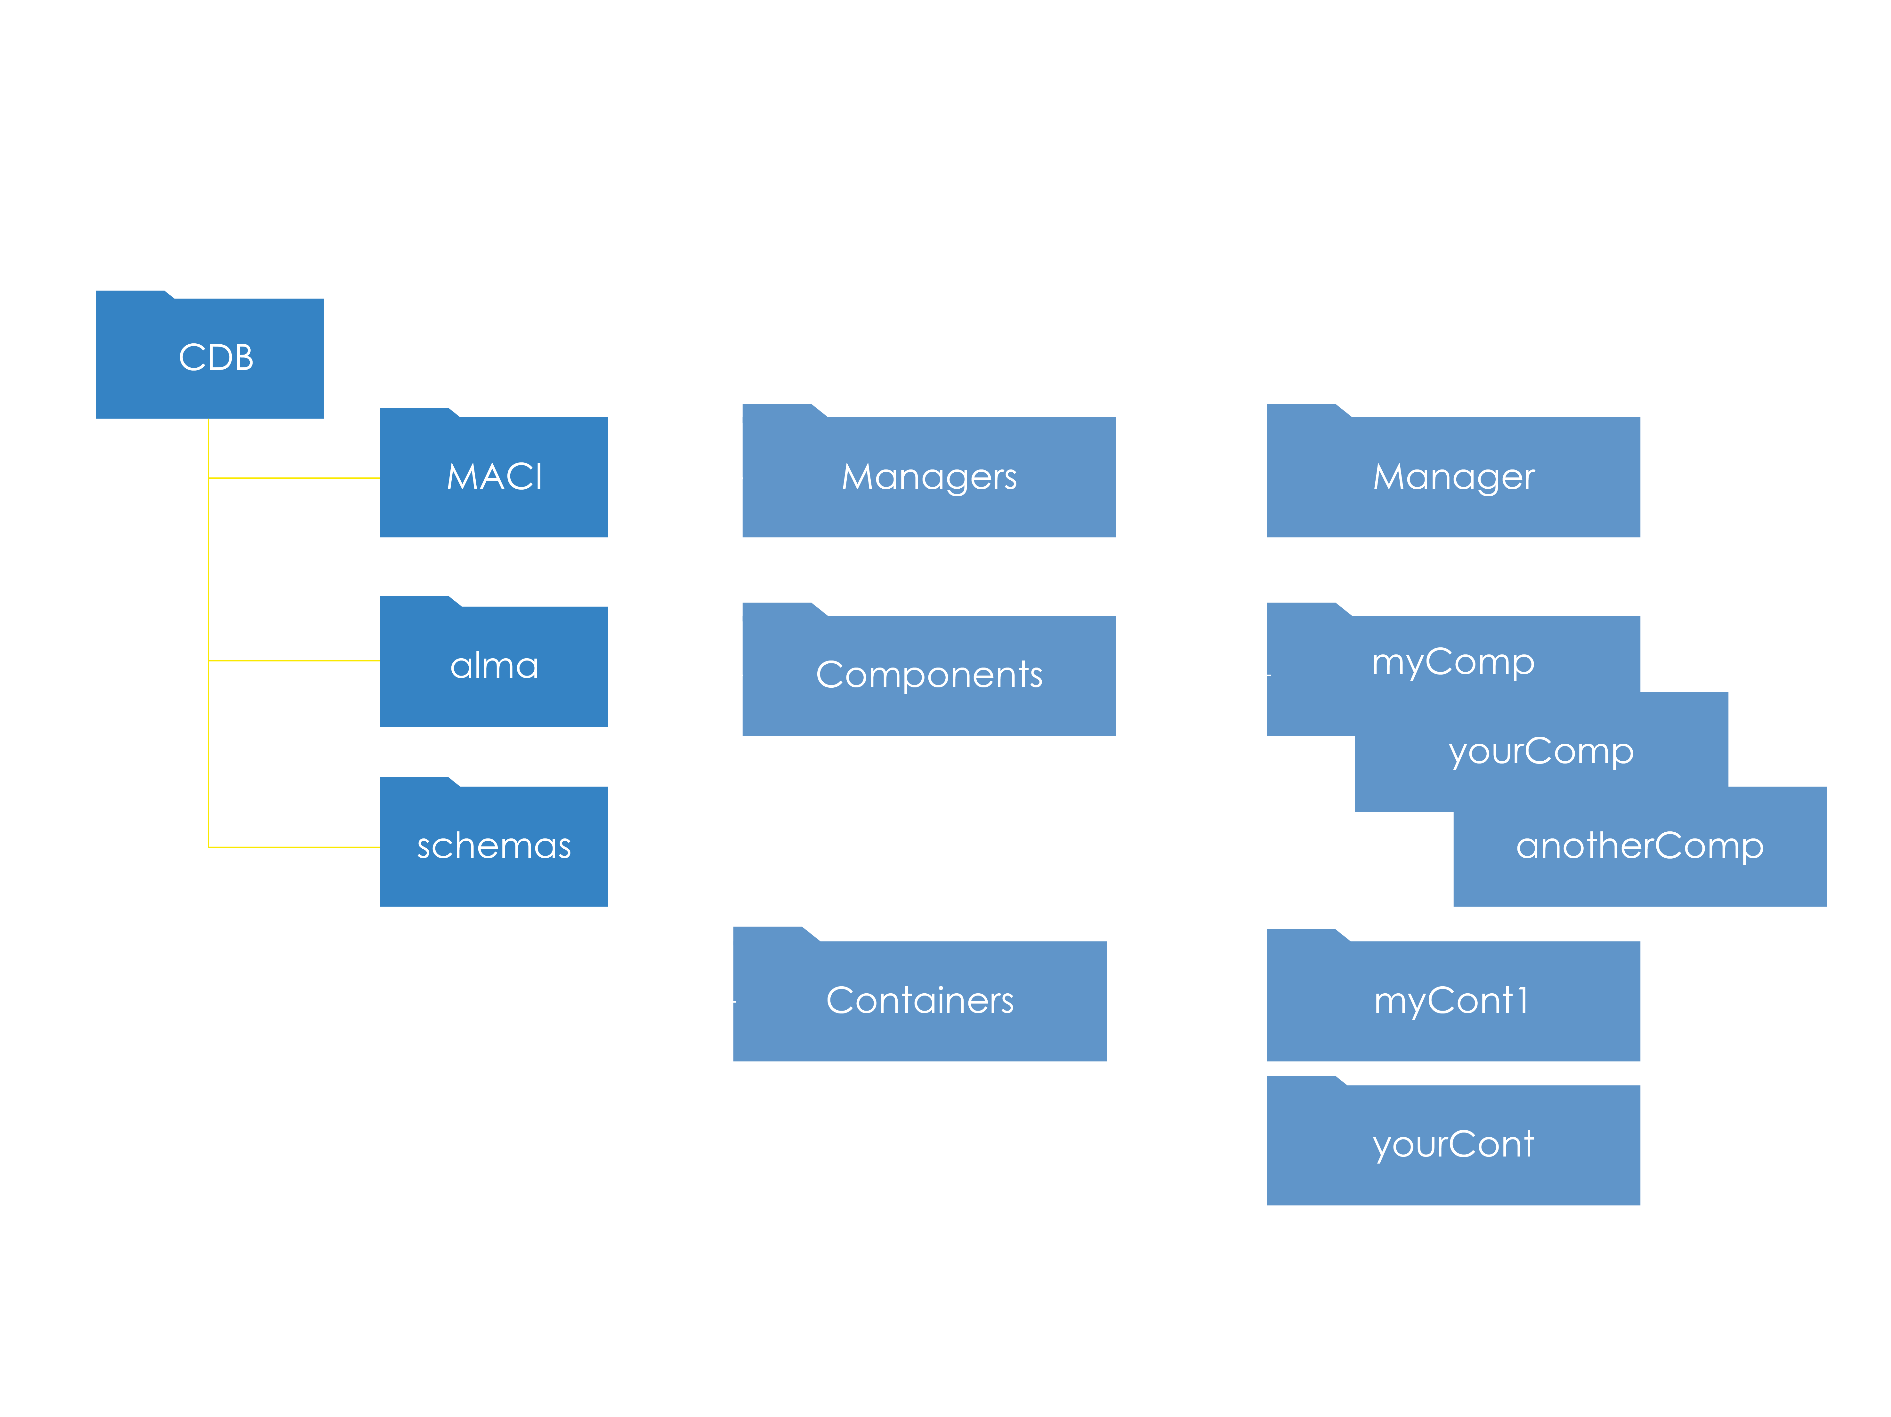
CDB/MACI structure

Slide 6
Components deployment info
Located at MACI branch
Deployment information distributed either in a single file (Components.xml) or a hierarchal collection of files
More information at “FAQHierarchicalComponentsAndCDBStructure” on the ACS wiki

Slide 7
Default CDB
jDAL (Java implementation of CDB) started as part of acsStartORBSRVC
Default file location: $ACSDATA/config/defaultCDB
Can be overwritten by using the $ACS_CDB environment variable
Test configuration data: <module>/test/CDB
CDB browser graphical tool available

Slide 8
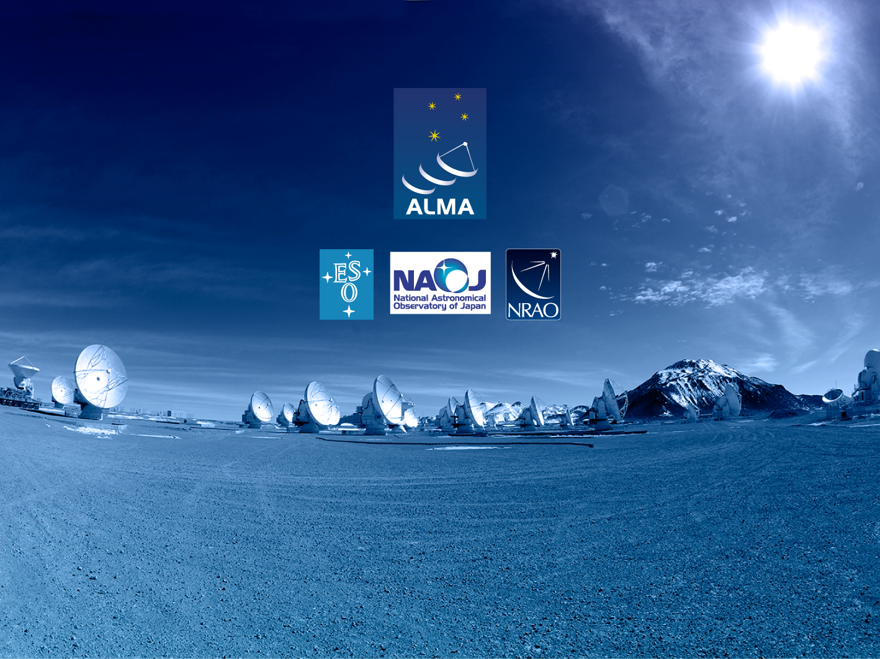
Questions?
Acknowledgements
ACS presentations were originally developed by the ALMA Common Software development team and has been used in many instances of training courses since 2004. Main contributors are (listed in alphabetical order): Jorge Avarias, Alessandro Caproni, Gianluca Chiozzi, Jorge Ibsen, Thomas Jürgens, Matias Mora, Joseph Schwarz, Heiko Sommer.
The Atacama Large Millimeter/submillimeter Array (ALMA), an international astronomy facility, is a partnership of Europe, North America and East Asia in cooperation with the Republic of Chile. ALMA is funded in Europe by the European Organization for Astronomical Research in the Southern Hemisphere (ESO), in North America by the U.S. National Science Foundation (NSF) in cooperation with the National Research Council of Canada (NRC) and the National Science Council of Taiwan (NSC) and in East Asia by the National Institutes of Natural Sciences (NINS) of Japan in cooperation with the Academia Sinica (AS) in Taiwan. ALMA construction and operations are led on behalf of Europe by ESO, on behalf of North America by the National Radio Astronomy Observatory (NRAO), which is managed by Associated Universities, Inc. (AUI) and on behalf of East Asia by the National Astronomical Observatory of Japan (NAOJ). The Joint ALMA Observatory (JAO) provides the unified leadership and management of the construction, commissioning and operation of ALMA.

